Slide 1
HudsonAlpha BioTrain Computational Bootcamp Morning Intro
James Lawlor
Computational Biologist, Greg Cooper’s Lab
HudsonAlpha Institute for Biotechnology
June 03, 2019

Slide 2
Computer Setup
https://james-lawlor.github.io/biotrain-2019/
Setup Bash
(Windows) Download Git BASH http://www.gitforwindows.org
(Mac/Linux) Included. Open the “Terminal” application.
Get data-shell.zip from SW Carpentry http://swcarpentry.github.io/shell-novice/setup.html
Install R https://cran.rstudio.com/
Install RStudio Desktop https://www.rstudio.com/products/rstudio/download/#download
Download r-novice-inflammation data

Slide 3
Morning Agenda
What is Computational Biology?
Computational Biology in the Cooper Lab
Bootcamp Intro
Goals
Helpers & Post-Its
Why learn Unix & R?
Unix Fundamentals
Introducing the Shell
Navigating Files and Directories
Working With Files and Directories
Pipes, Filters, and Loops (brief overview of advanced topics)
Aside: Accessing the HudsonAlpha Compute Cluster
Keeping a Computational Lab Notebook and Getting Programming Help
Lunch!

Slide 4
What is computational biology?
“Computational biology and bioinformatics is an interdisciplinary field that develops and applies computational methods to analyze large collections of biological data, such as genetic sequences, cell populations or protein samples, to make new predictions or discover new biology.” -- Nature.com

Slide 5
In other words…
Use computational tools
Programming
Mathematical models & machine learning
Databases
Physics simulations
To analyze huge sets of data
Genome sequencing
Protein modeling
And answer biological questions
How does this gene work?
Does this disease have a genetic pattern?
How are these species related?
What makes a liver cell different from a brain cell?

Slide 6
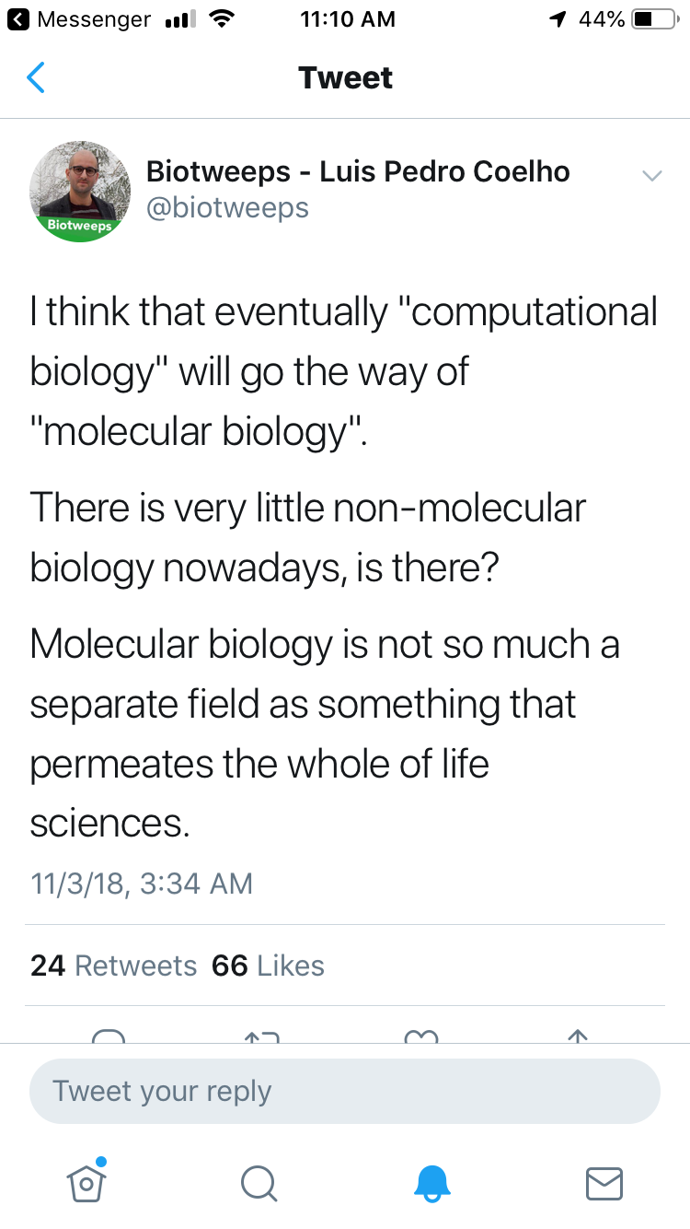

Slide 7
Terminology
The terms “bioinformatics” and “computational biology” are often used interchangeably:
Bioinformatics: Software tools, databases, visualization methods
Computational Biology: Data analysis, algorithm development, mathematical modeling
Other terms for the intersection of biology / math / computer science:
Data Science, Systems Biology, Statistical Biology, Biostatistics, Genomics (implicit), _____omics, Clinical Informatics, etc…

Slide 8
The bottom line:
Computational skills are increasingly critical for biology & many other fields
Hands-on experience is a huge first step
Notes:
Being able to say “I’ve done that before” is huge, even if you don’t remember a lot of it or didn’t feel like you were good at it.

Slide 9
PLACEHOLDER FOR BRYAN

Slide 10



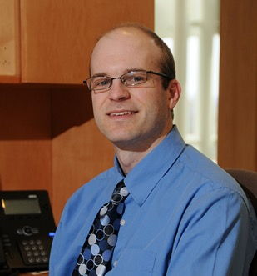

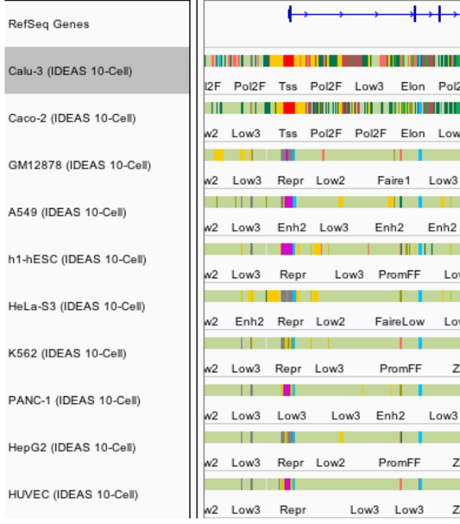
About Me
B.S.: Biochemistry & Mathematics
M.S.: Modeling & Simulation
Greg Cooper Lab
HudsonAlpha
Computational Biologist
Advisor: Eric
Mendenhall
Notes:
One-minute version of my career path
Got my undergrad degree at UAH, where I knew I wanted to study science and make that into a career path, but wasn’t quite sure which direction I wanted take that
Took a few years to work in industry, doing cost analysis for the DoD
Masters in M&S at UAH:
Worked with Eric Mendenhall and studied the regulation of the CFTR gene
Integrated and optimized several machine learning tools to predict different patterns of CFTR gene regulation in different cell types, with the goal of being able to find enhancers and other genetic elements that cause CFTR to be highly expressed in some types of cells and minimally expressed in others
That opened up the opportunity for me to go work as a Computational Biologist with Greg Cooper’s Lab at HudsonAlpha, where we use genome sequencing to diagnose pediatric rare disease, especially DD/ID
So, I write software and analyze genome sequencing data to help us ask and answer questions about the genetic cause of disease
But how did I get here today? I think that’s fun to point out, because it stems a lot from one of my hobbies, which is patient advocacy for Cystic Fibrosis, which has given me some great opportunities to connect with other adults with CF like myself, including Xan Nowokowski. After Xan and I connected at a CF Foundation virtual event, we began talking about our respective science and research careers, and they were kind enough to bring me here to speak

Slide 11
Cooper Lab Research

Slide 12
Why seek genetic diagnoses?
Notes:
* Why seek genetic diagnoses when we are already treating the symptoms of a disorder?

Slide 13
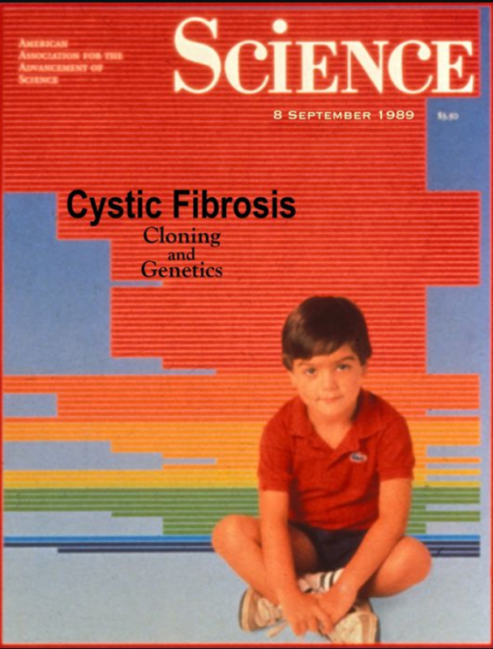
Disease-gene relationships are critical to scientific advancement & treatment
Basic Science: CFTR. (2017). Retrieved from http://www.hopkinscf.org
Notes:
But first I want to pause and reiterate why this basic science that does the work of linking new diseases to genes is so important. In my own life as a CF patient, I’ve been able to witness the direct impact of knowing precisely how a congential disease is affecting the patients on a genetic and molecular level. CFTR, the causative gene for Cystic Fibrosis, was found in 1989, and we eventually learned that it encodes a chloride channel whose malfunction causes the thick mucus that is the hallmark of this disease. This understanding has been critical to a majority of the treatments that I use every day. And that’s why

Slide 14
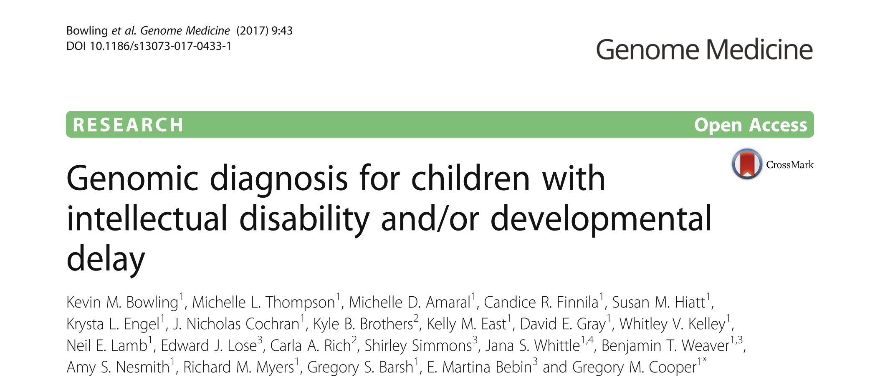
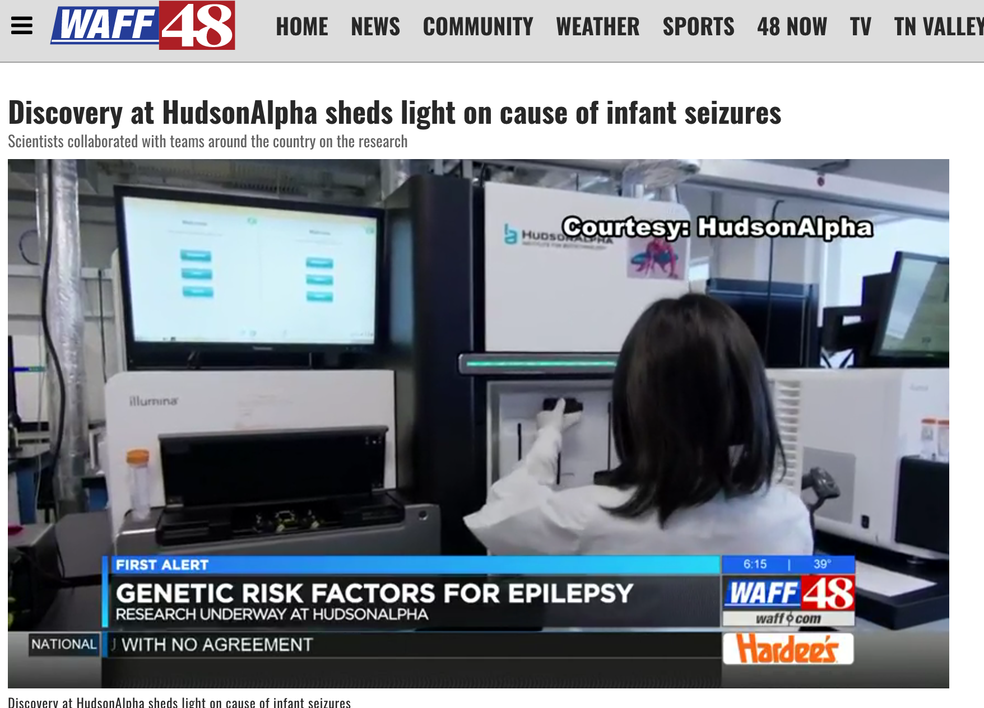
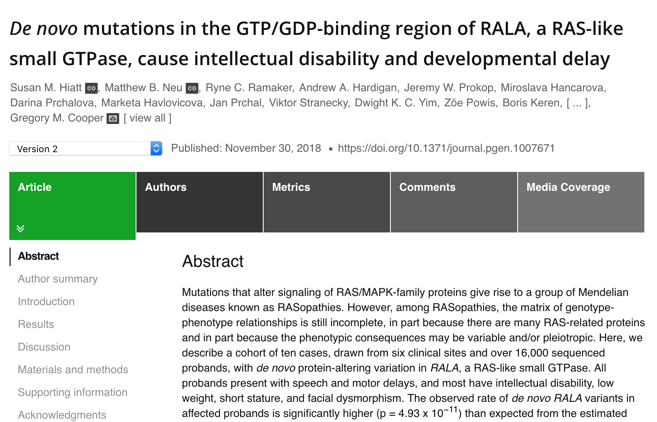

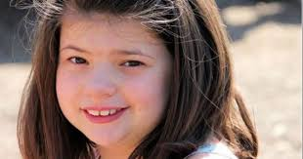
Disease-gene relationships are critical to scientific advancement & treatment

Slide 15


Developmental Delay Diagnosis
Sequence affected individuals + parents
> 800 affected individuals sequenced
Re-analyze cases every ~2 years

Slide 16
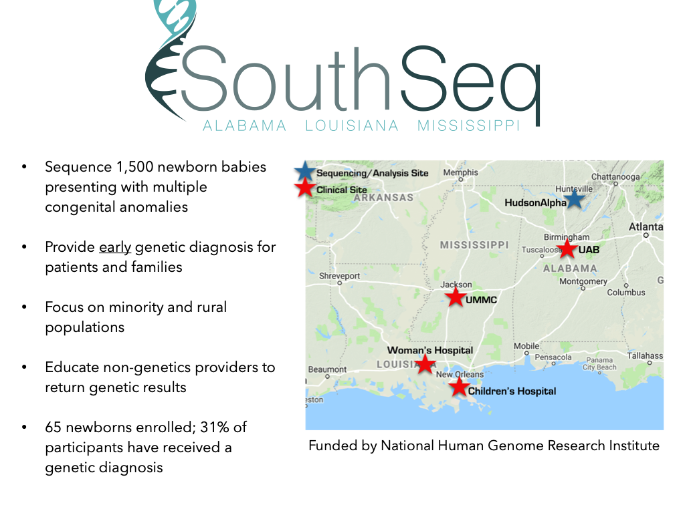
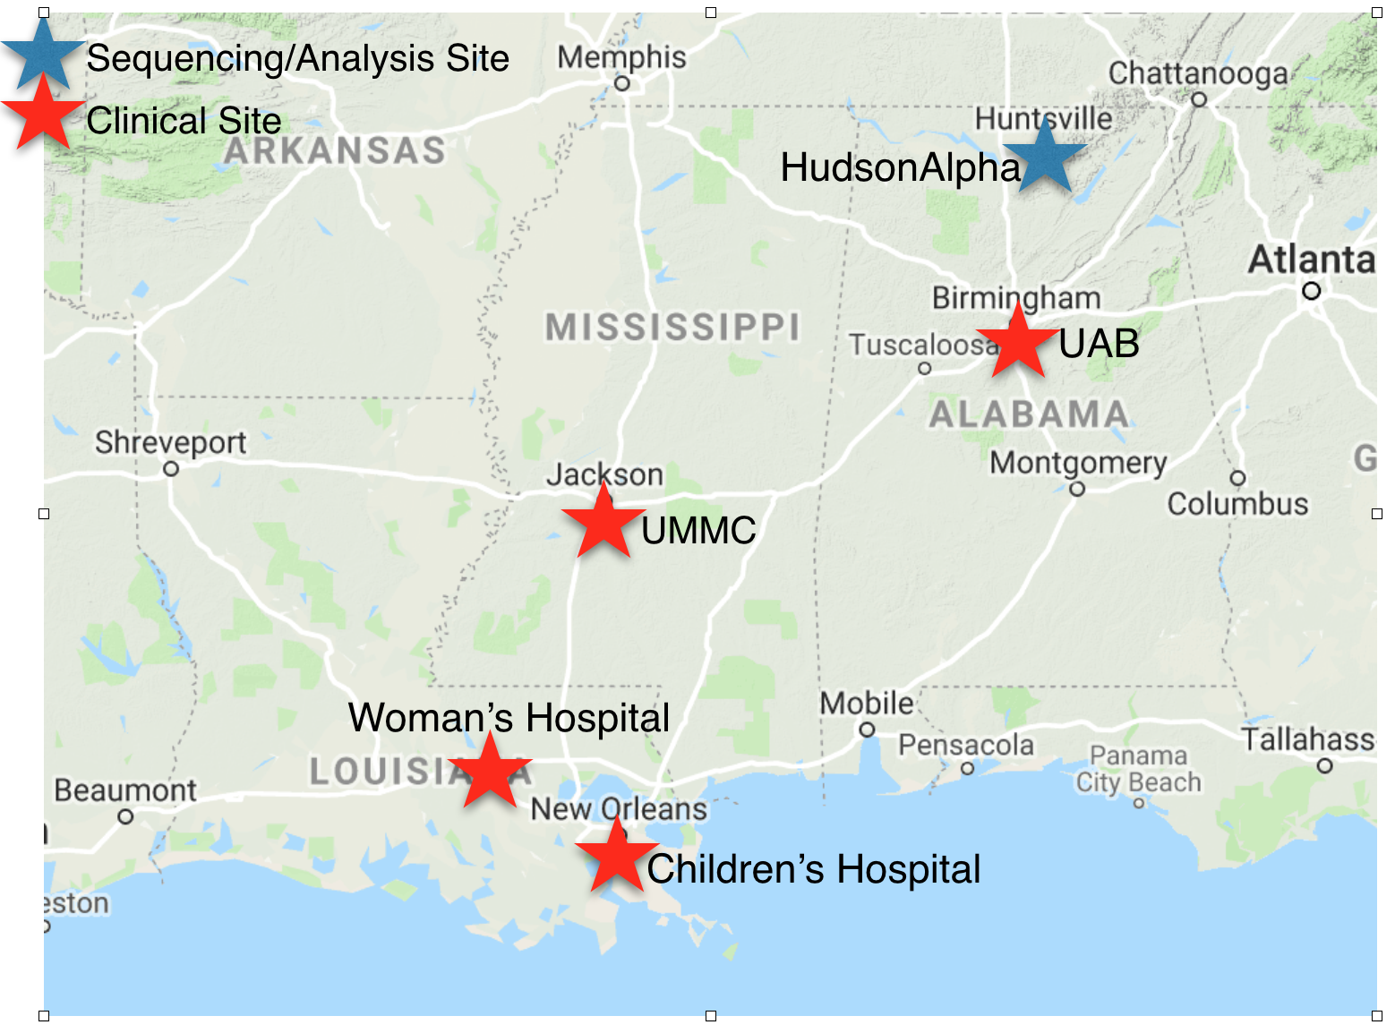
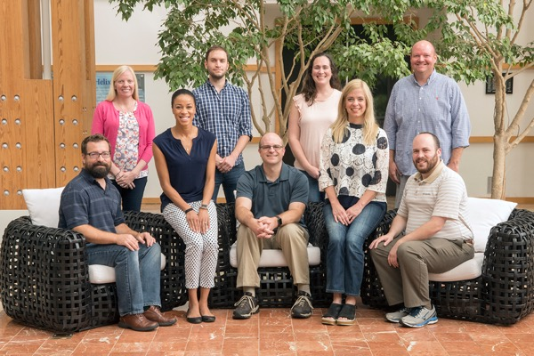
SouthSeq: Genomic Diagnoses for Newborns
Sequence ~1,500 newborns w/ congenital anomalies
Spare patients diagnostic odyssey
Minority / rural focus
Greg Cooper Lab, HudsonAlpha

Slide 17
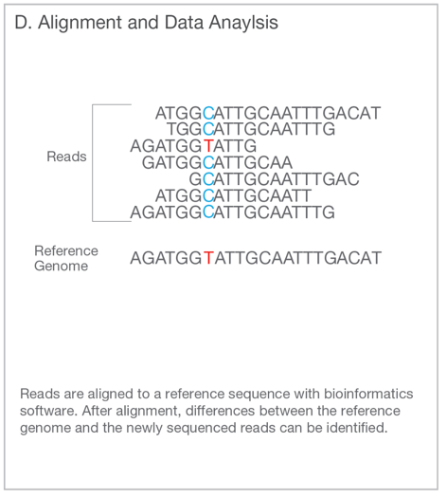
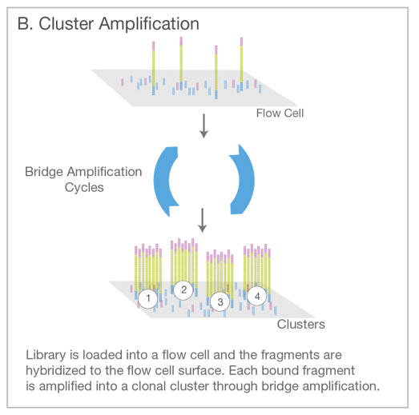
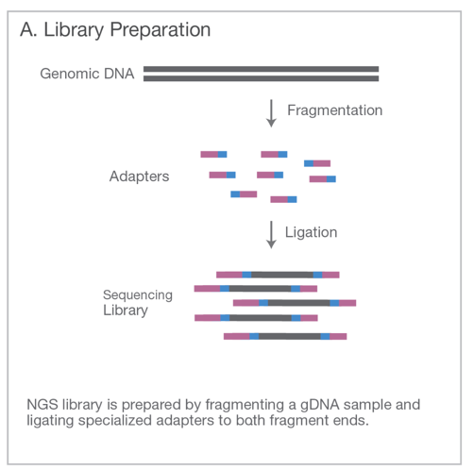
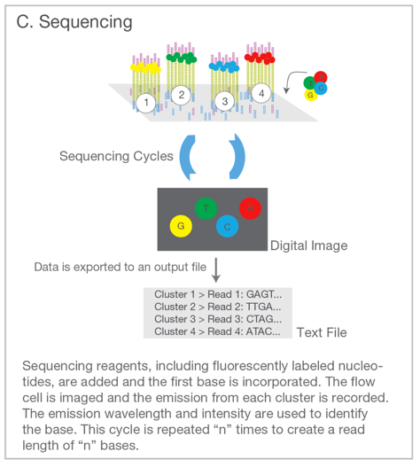
Genome Sequencing (Short Read)
Illumina. An introduction to Next-Generation Sequencing. (2017).

Slide 18

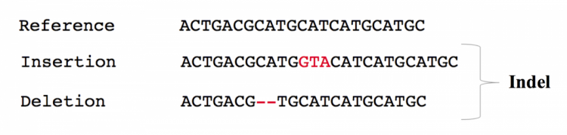
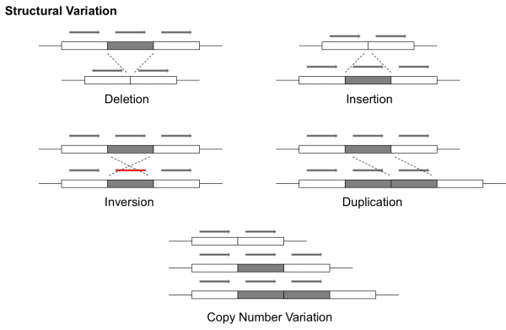
Result: Millions of variants for each person
Each kind of variation requires a different algorithm (or multiple algorithms) to detect from short read data.
EMBL. EMBL-EBI Training (2019).
Notes:
Since our focus is inherited disease, we’re looking at a patient’s DNA

Slide 19
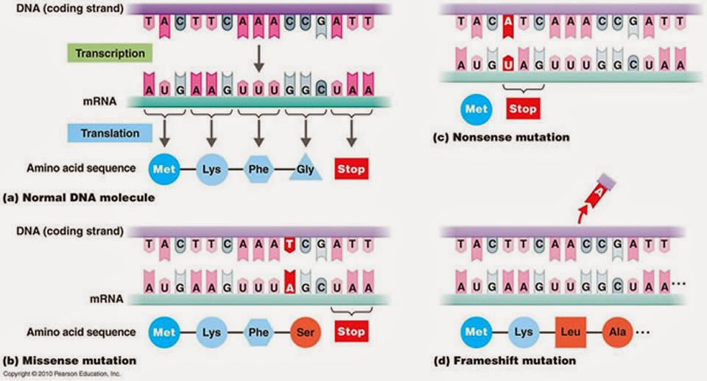
Best-understood variants alter proteins

Slide 20
Filtering / Analysis / Interpretation is key
~4,000,000 variants
population frequency
genomic annotations
computational predictions
inheritance pattern
clinical disease databases
phenotypes
published literature
~1 causal variant
We evaluate the totality of existing evidence for a particular variant

Slide 21
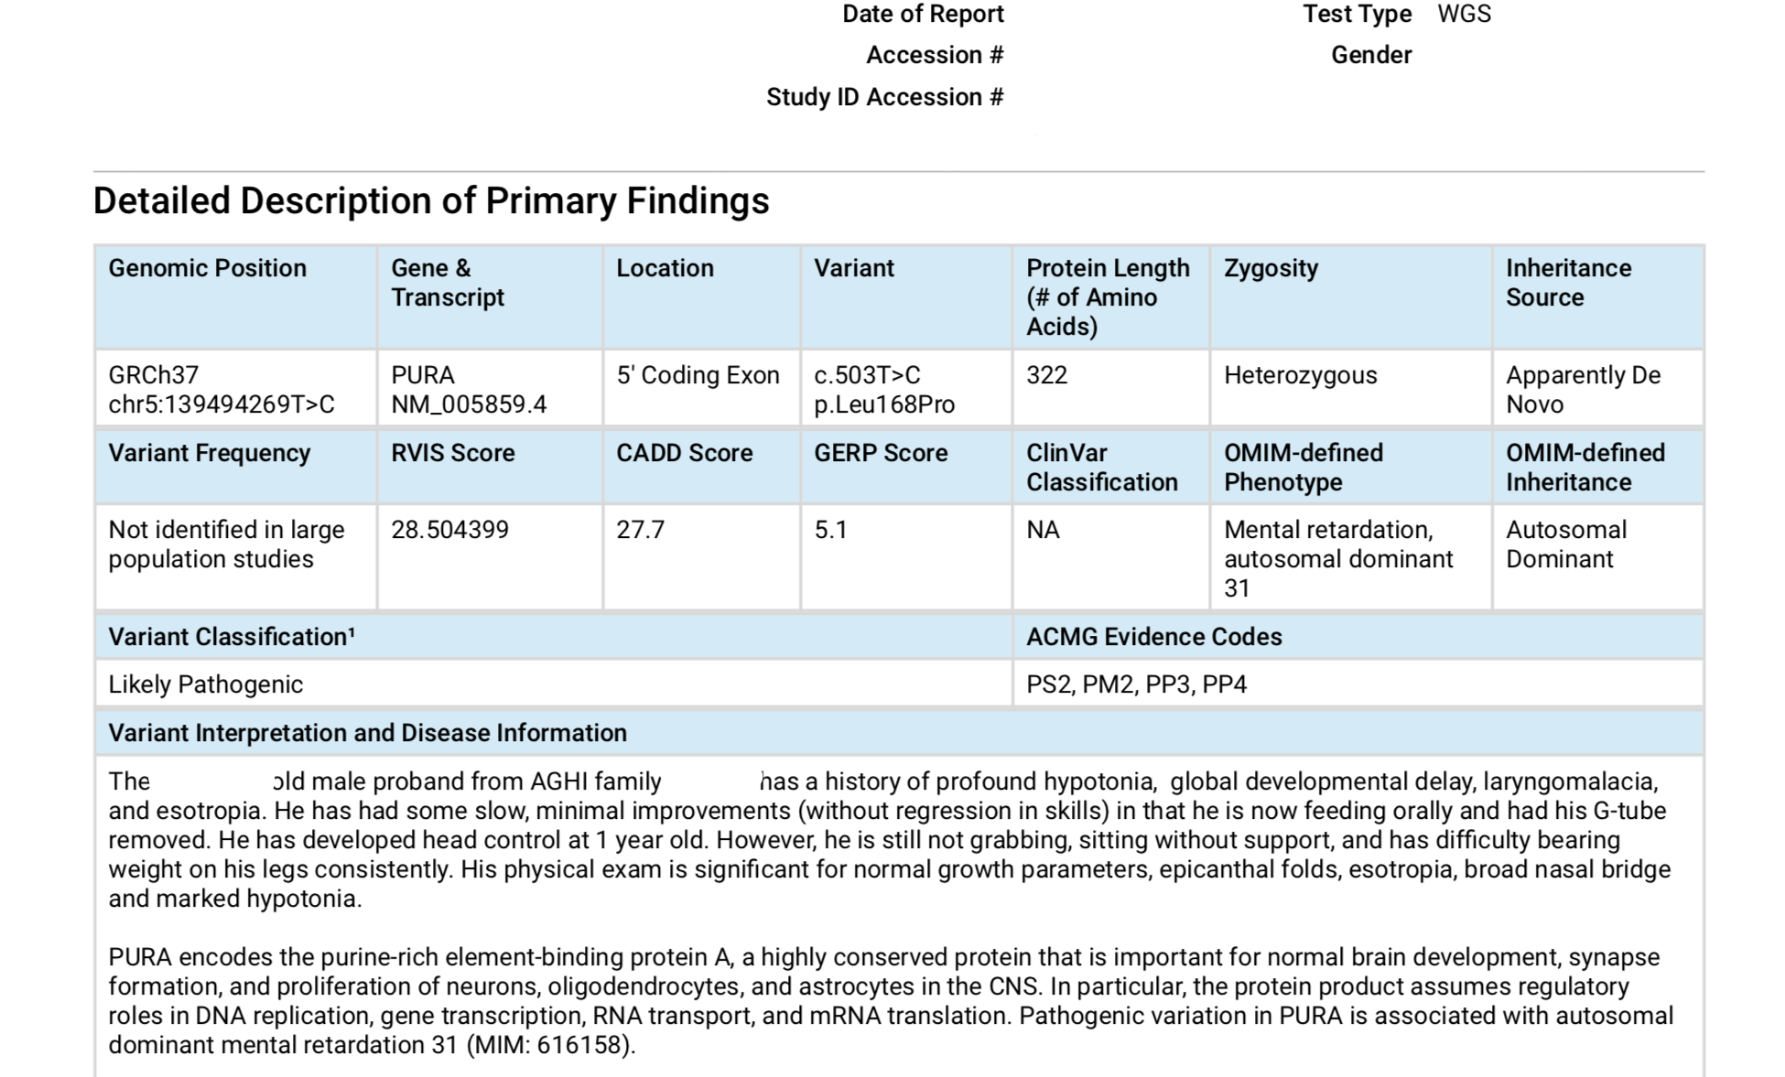
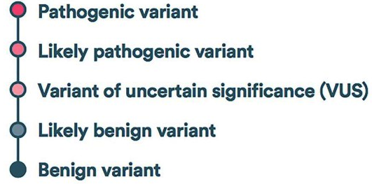
Detailed variant reports are returned to providers
Notes:
*Elminate blank space in report

Slide 22
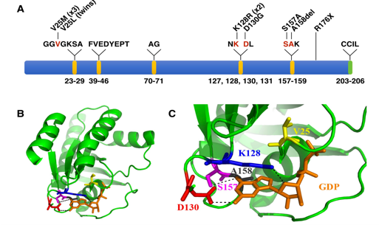
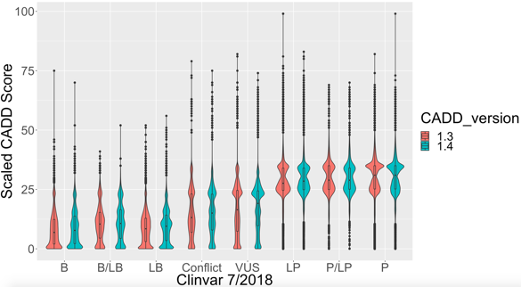
Our Goal: Increase Diagnoses
Describe new disease genes
Analyze more types of variation
Evaluate & improve computational models

Slide 23
Machine Learning

Slide 24
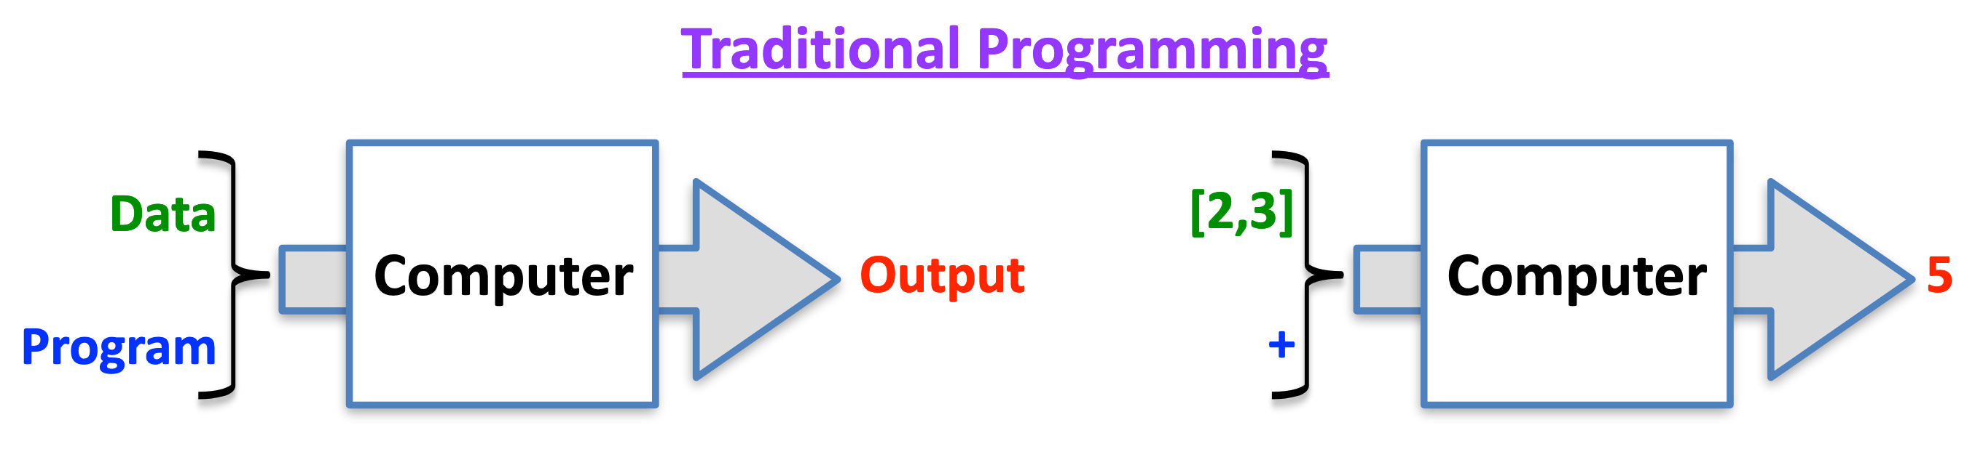
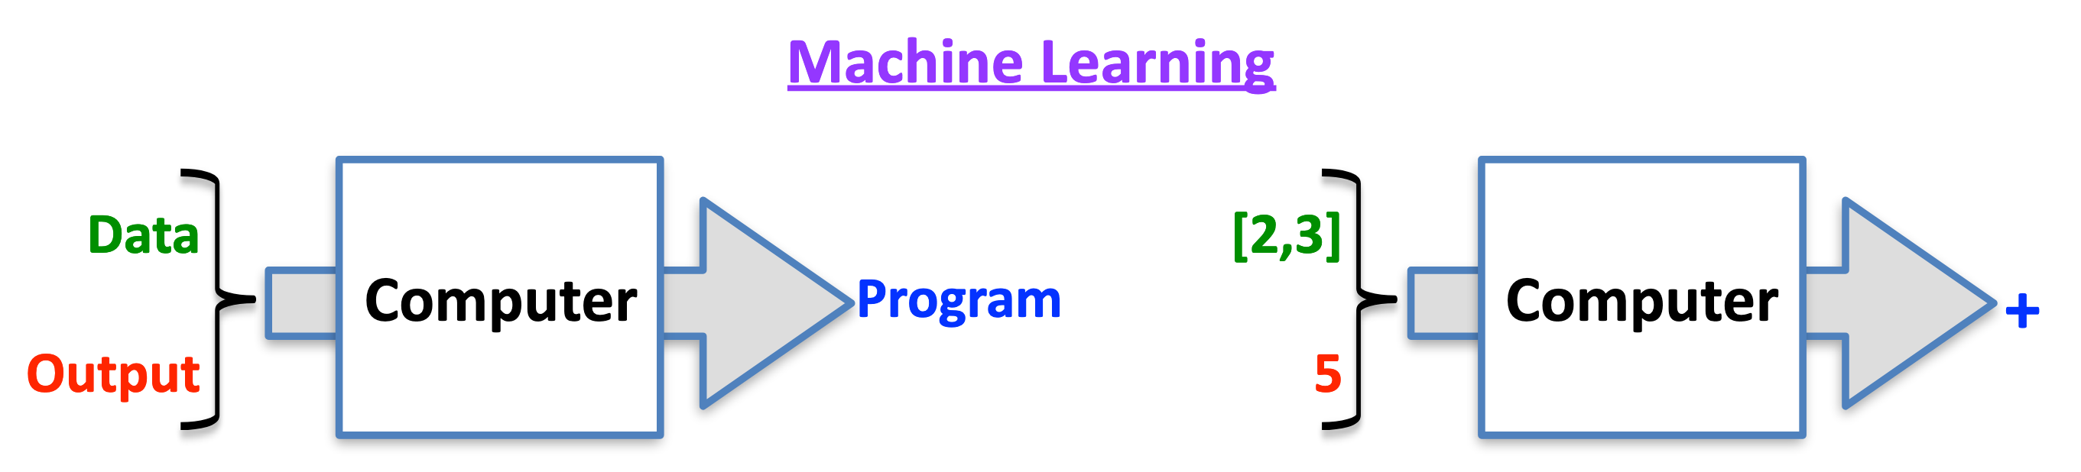
Machine Learning
Data analysis methods to automate analytical model-building
Use data to:
Make predictions
Discover patterns
Useful for complex problems + large amounts of data
Goal: useful not perfect

Slide 25
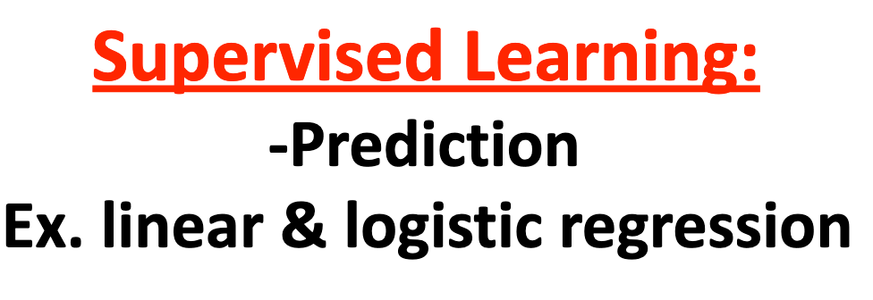
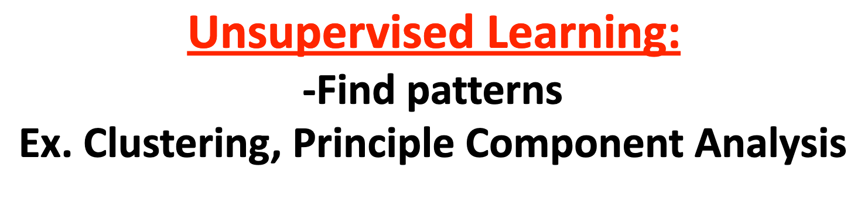
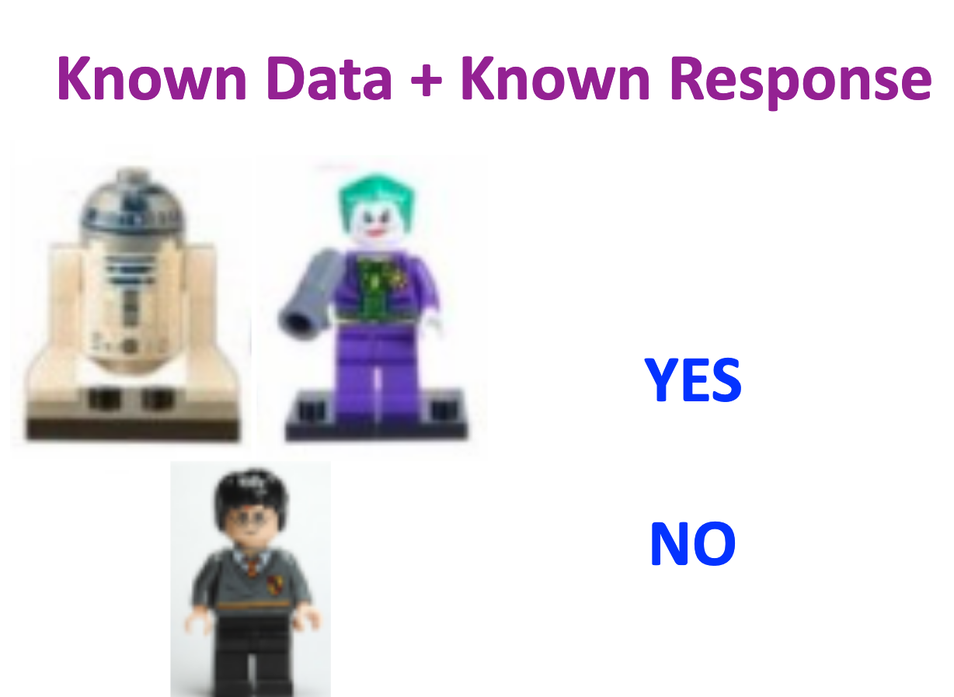
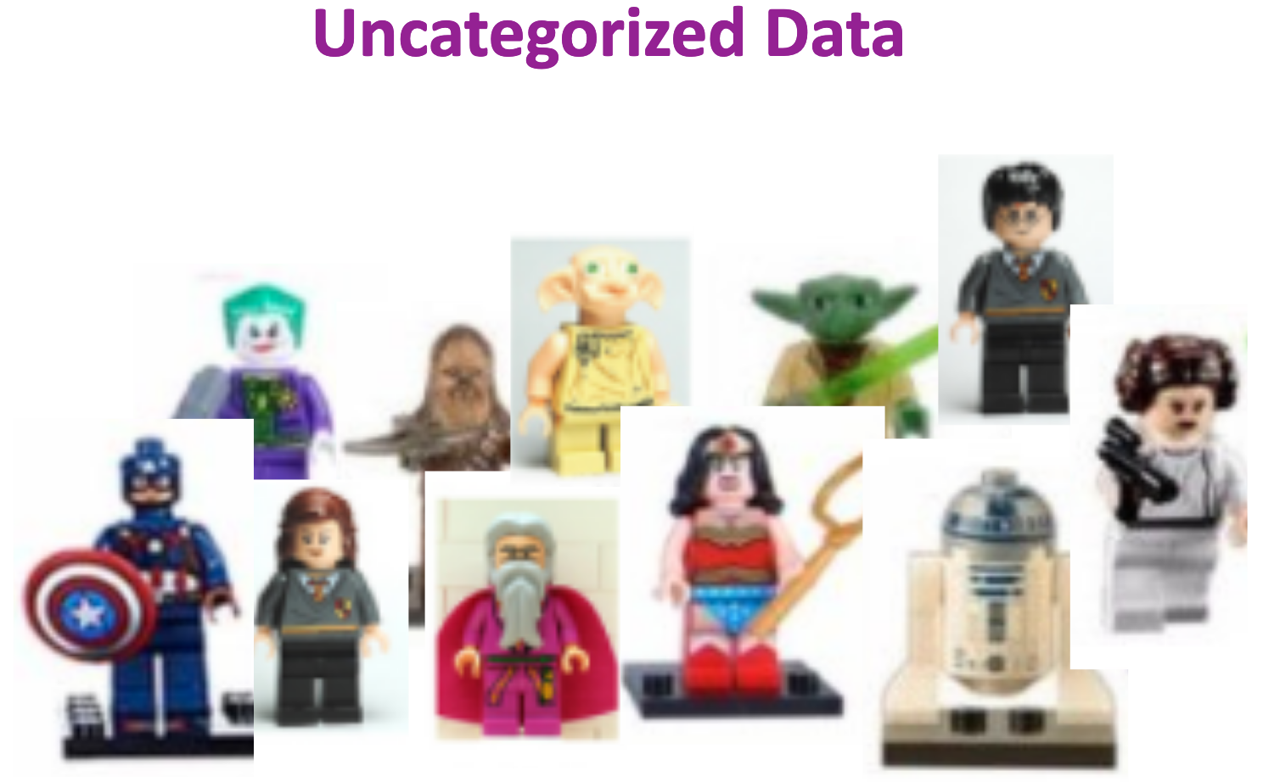
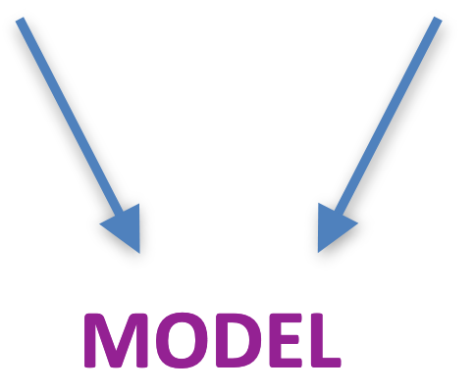
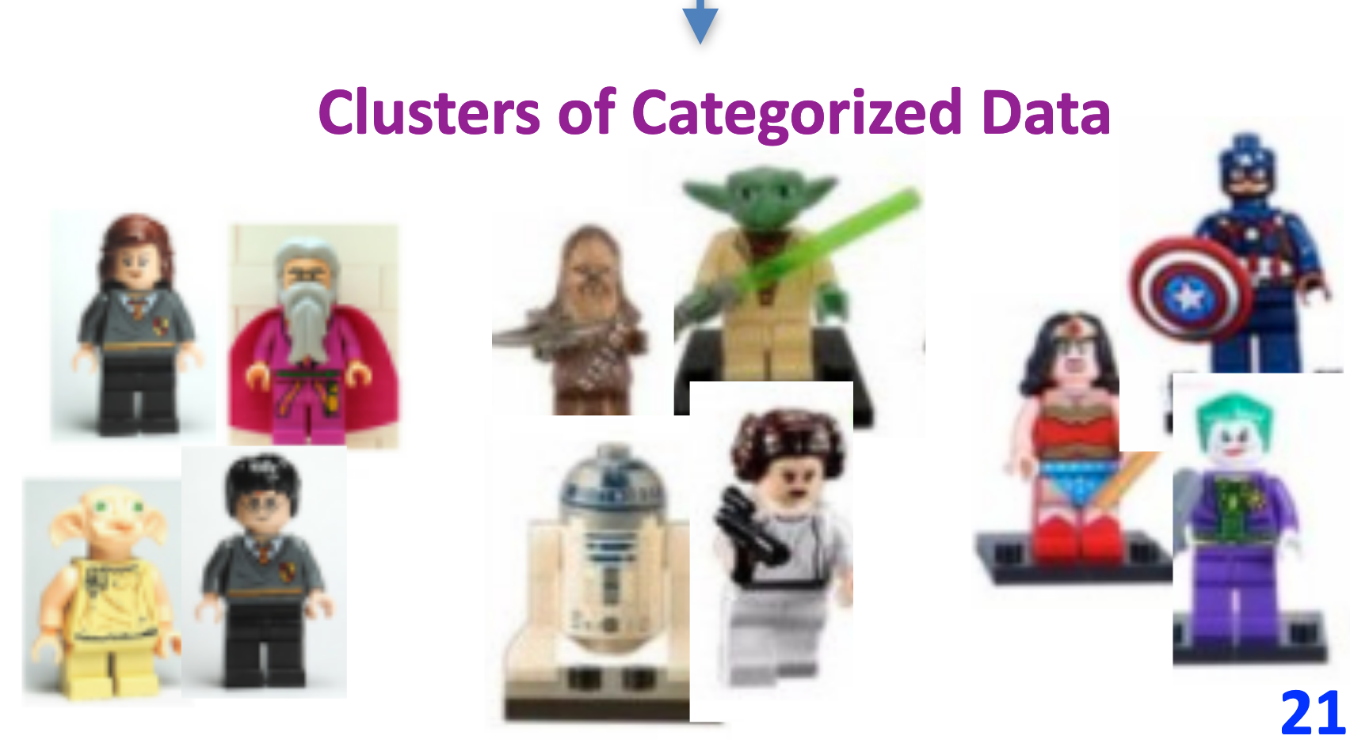
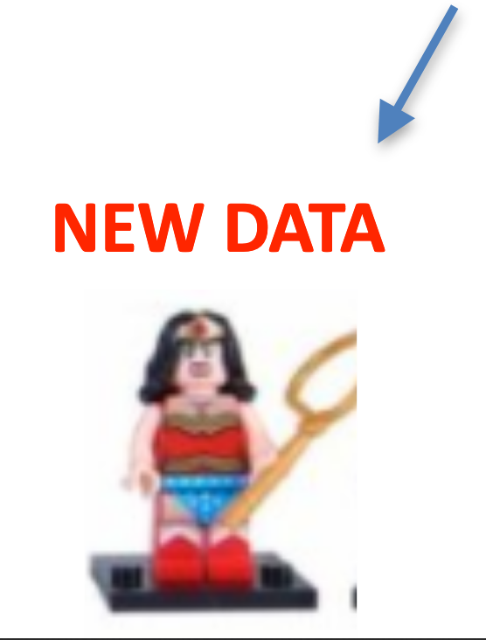
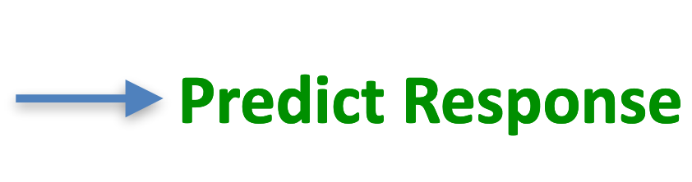
Supervised & Unsupervised Learning

Slide 26
Tools & Data
CADD – Combined Annotation Dependent Depletion

Slide 27
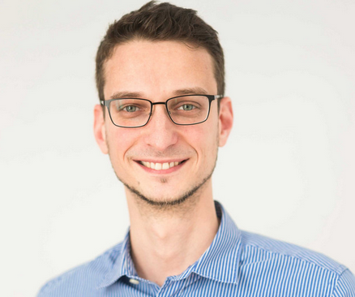
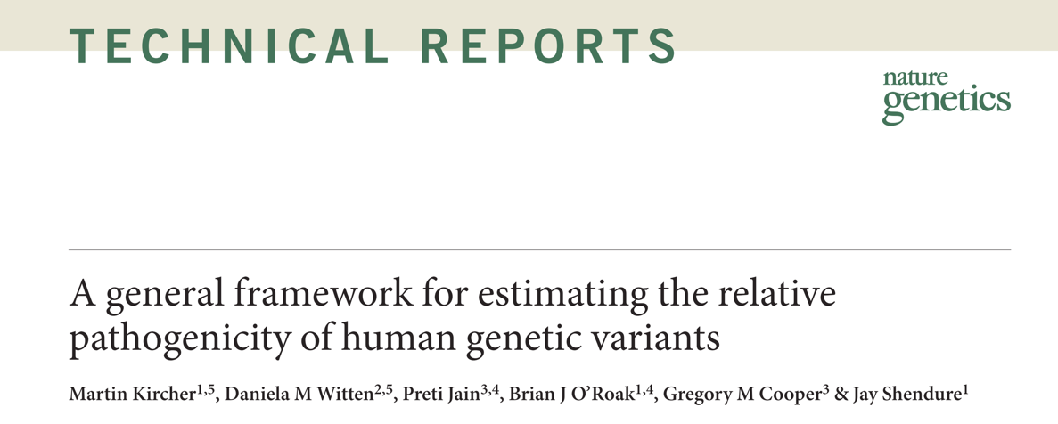
Combined Annotation-Dependent Depletion
CADD:
Predicts deleterious variants
Integrates >100 types of genomic data
Helps prioritize variants
PI: Martin Kircher, PhD
Berlin Institute of Health
Philipp Rentzsch
Notes:
CADD is a computational tool that integrates diverse genomic data to predict deleterious variants.
Published 2014.
We like that it integrates >100 types of genomic data in a reasonably unbiased way. For example, the model includes conservation and protein-coding effects of variants, but it’s not restricted to only dealing with those types of variants.
Deleterious and pathogenic aren’t quite the same thing—deleterious refers to evolutionary fitness and pathogenic refers to clinical disease. But often, the two are strongly correlated and deleteriousness can be a piece of evidence we use in determining if a variant is pathogenic.

Slide 28
Step 1: Use evolutionary biology to find variants harmful to humans

Slide 29
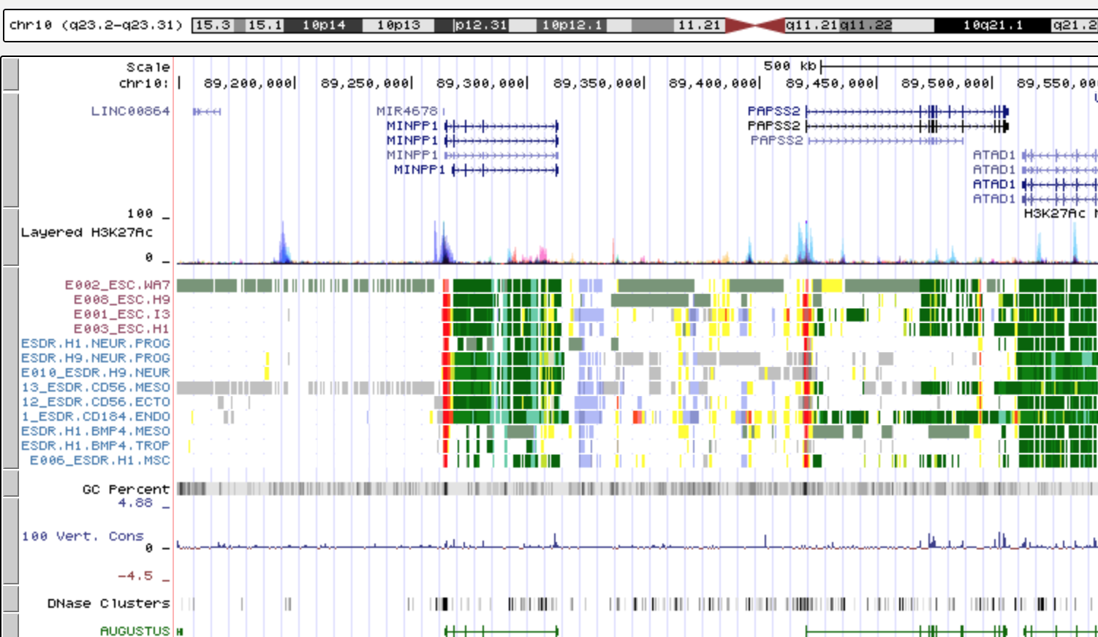
Step 2: Collect Variant Data
>100 annotations, including
Variant effect
Conservation
TFBS Motifs
Biochemical (open chromatin, histone modifications, etc.)
Protein structure
Local SNV Frequencies
Notes:
Variant effect predictions, such as “frameshift” or “regulatory motif disruption”

Slide 30
Step 3: Computational Model
Regression model learns characteristics of harmful variants
Model ranks all possible variants from least deleterious to most deleterious
Convert to score: CADD 10: Top 10th %ile
CADD 20: Top 1st %ile CADD 30: Top 0.1 %ile

Slide 31
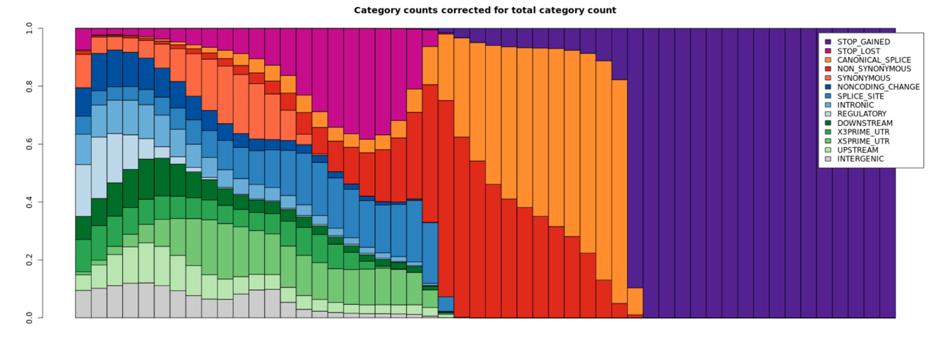
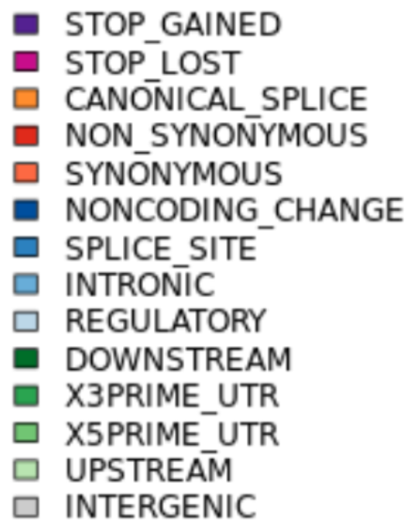
Protein-altering variants have high CADD score
CADD Increasing ->

Slide 32
Tools & Data
Codicem – Genome-scale clinical analysis and interpretation

Slide 33
CODICEM is a variant analysis platform used by several researches at HudsonAlpha
Ingest variants
Annotate with supporting data
Protein effects
Conservation
CADD
Existing disease/gene association
Filter variants
Team variant curation
Report generation
~4,000,000 variants
~1 causal variant

Slide 34
Variants are filtered by their characteristics
,
5,285,977 variants
4,994,771
Sequencing Quality
≥8 reads, ≥15% reads support allele
187,110
Population Frequency
≤ 0.01%
11,468
Predicted Damaging
Affects Protein OR Top 10th %ile CADD
273
Genomic coordinates near a gene
Exclude Intergenic or Unknown Effect
Manual Review:
Inheritance
Literature
Biology
~1
Notes:
Recall, there are 3-5 million variants per person
Show numbers

Slide 35
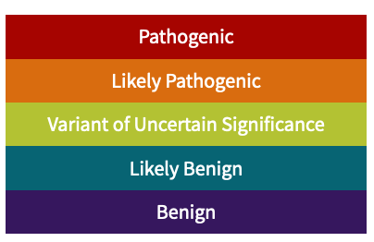
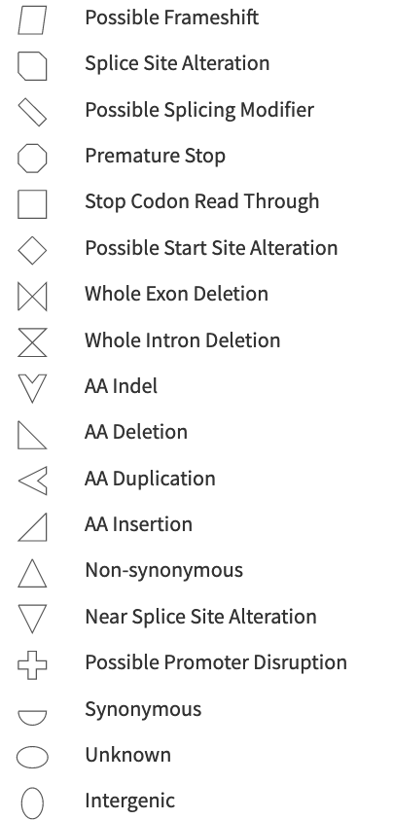
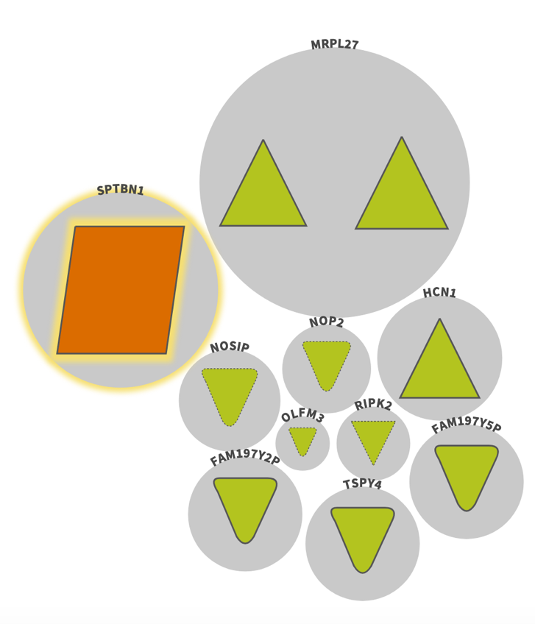
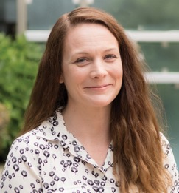
A small set of high-impact variants is amenable to manual review
PI: Liz Worthey, PhD
Notes:
Analysts review for link to phenotypes

Slide 36
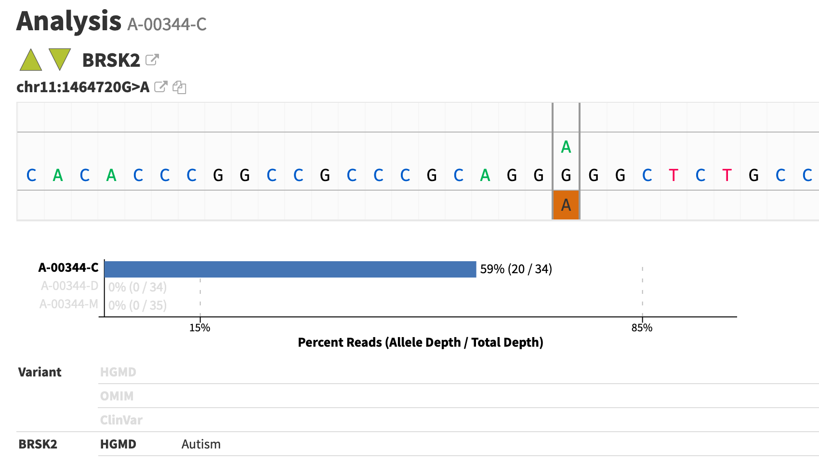
Analysts review filtered variants for potential link to patient’s phenotype

Slide 37
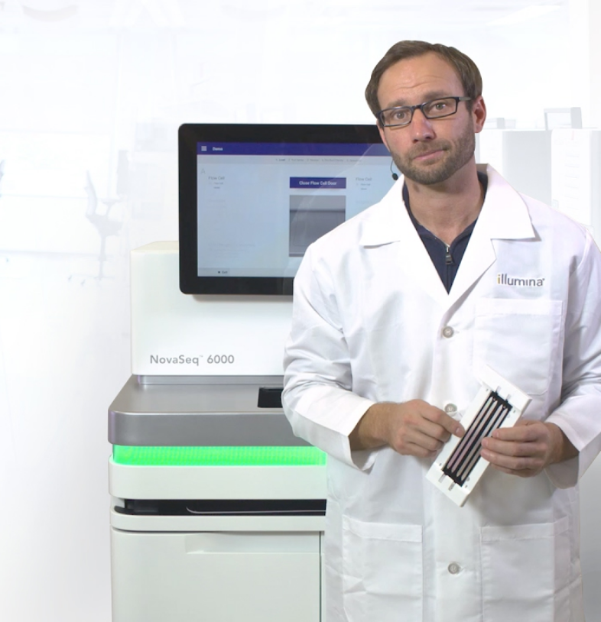
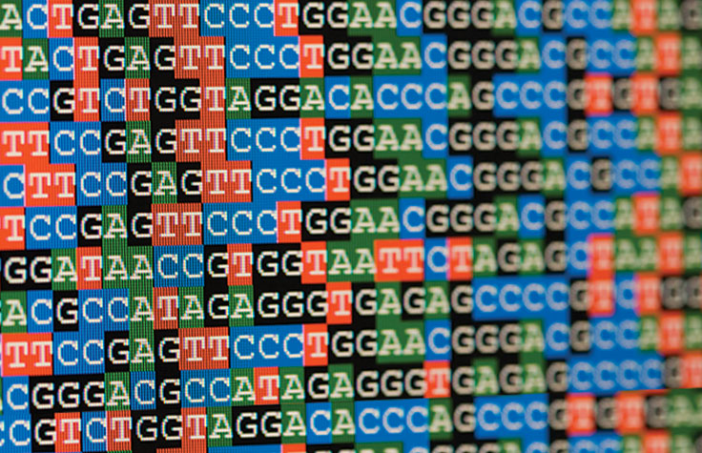

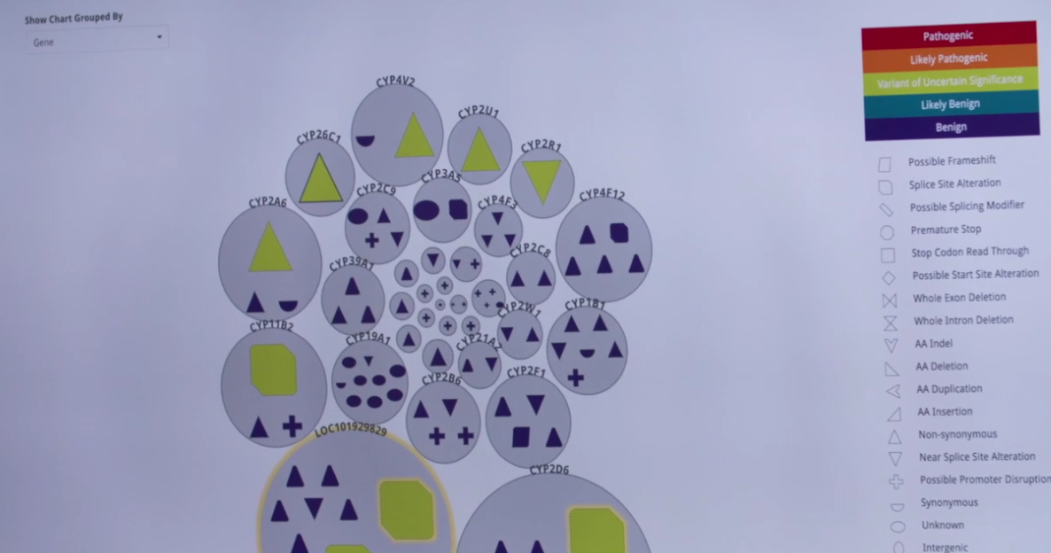
The Challenge
Me
Sequencing lab
Software Developers
Genomic Analyst
Notes:
Me
Sequencing lab
Generates data
Software Developers
Make analysis software
Genomic Analyst
Investigate patient disease & variants

Slide 38

Typical Day
Ask questions:
What can I explore today?
How can I make this process…?
Faster
More reliable
More informative
Evaluate existing tools
Write code
Python
R
Bash
Write about what I did:
For myself
For my collaborators
For the bigger scientific community

Slide 39
Critical Skills
Tech
Science
Communication
Troubleshooting
New languages & tools
Programming
Tech writing
Public speaking
Teamwork
"Translating"
Genetics & Biochemistry
Statistics
Compute clusters
Scientific Literature
Unix
Business Process
Automation
Documentation
Data management

Slide 40
Summary

